Slide 1
Understanding Sequence-to-X models with Borzoi
Baranzini Lab Meeting
Presenter: Wanjun Gu

Slide 2
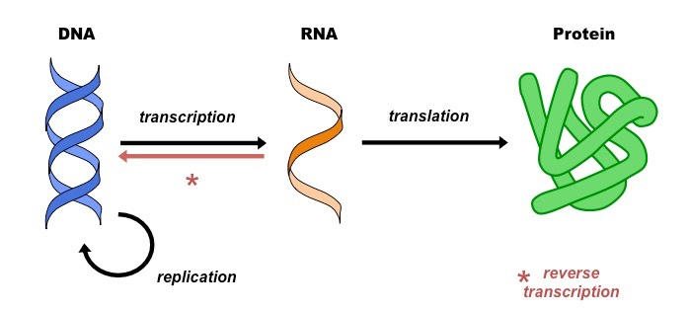
Central dogma of biology
Notes:
Simple Explanation: The figure shows how many connections (edges) and elements (nodes) are in different parts of the interactome, which is a network of protein interactions. The largest component is from the STRING database, followed by the OTAR dataset. Smaller contributions come from IntAct, Reactome, and SIGNOR, showing how these sources combine to form a comprehensive network.

Slide 3
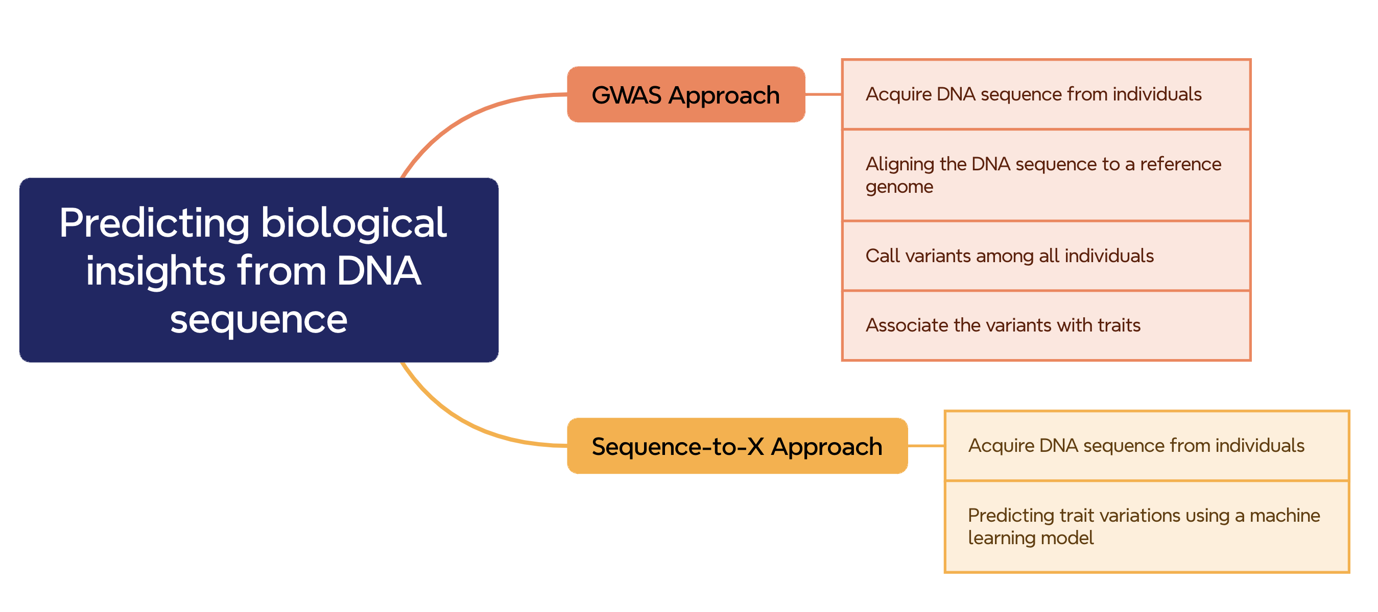
Predicting biological insights from DNA sequence

Slide 4
Advantages of using a sequence-to-X method
- Capturing the additive/non-additive effects of multiple variants from the same haplotype
- Capturing long-distance interaction in the genome
- Rich modalities of predicted values in addition to association statistics (maps, tracks, coverage, etc.)

Slide 5
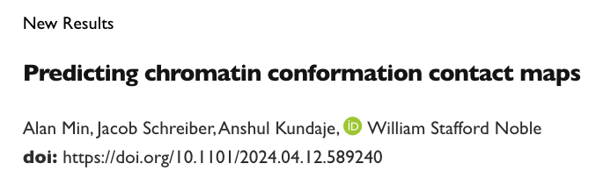
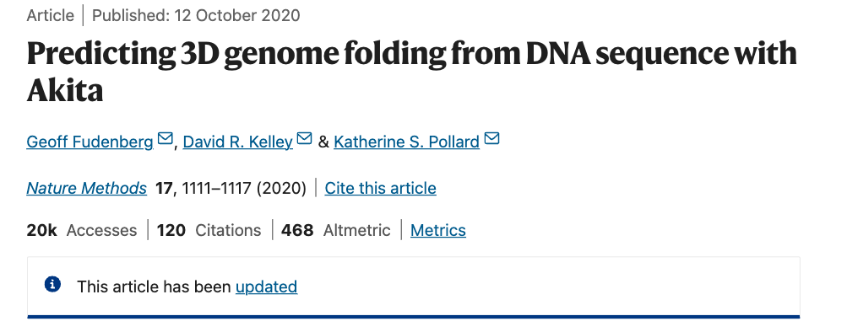
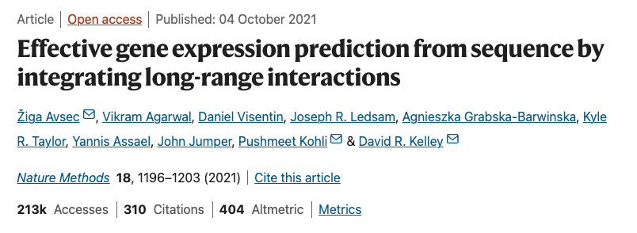
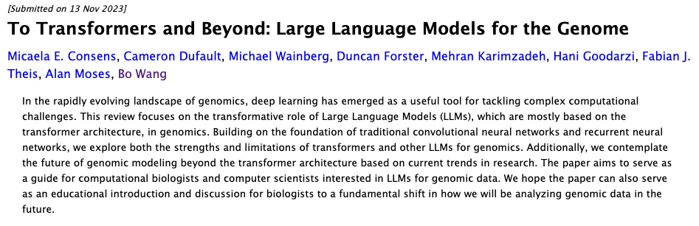
Many sequence-to-X methods are emerging at the moment
Notes:
Simple Explanation: The figure shows how many connections (edges) and elements (nodes) are in different parts of the interactome, which is a network of protein interactions. The largest component is from the STRING database, followed by the OTAR dataset. Smaller contributions come from IntAct, Reactome, and SIGNOR, showing how these sources combine to form a comprehensive network.

Slide 6

Predicting RNA-seq coverage from DNA sequence using Borzoi
Notes:
Simple Explanation: The figure shows how many connections (edges) and elements (nodes) are in different parts of the interactome, which is a network of protein interactions. The largest component is from the STRING database, followed by the OTAR dataset. Smaller contributions come from IntAct, Reactome, and SIGNOR, showing how these sources combine to form a comprehensive network.

Slide 7
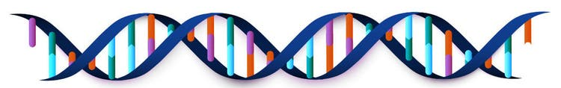
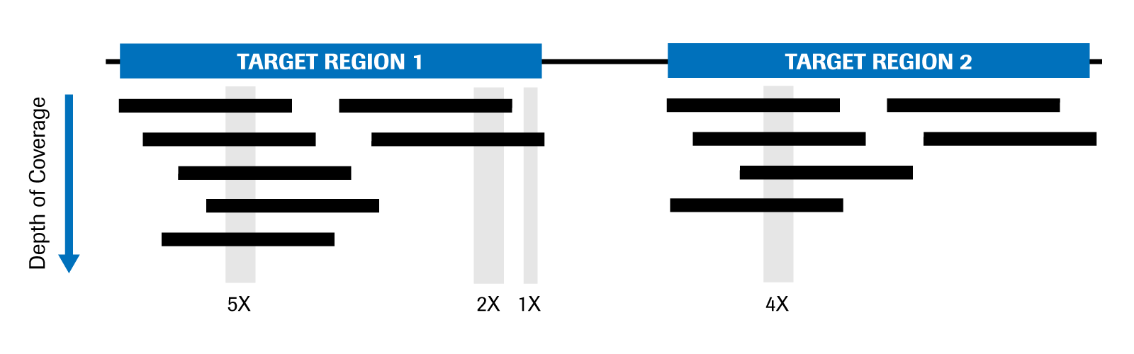
Objective of the model
DNA sequence
Predict
RNA Sequencing Coverage
Notes:
Simple Explanation: The figure shows how many connections (edges) and elements (nodes) are in different parts of the interactome, which is a network of protein interactions. The largest component is from the STRING database, followed by the OTAR dataset. Smaller contributions come from IntAct, Reactome, and SIGNOR, showing how these sources combine to form a comprehensive network.

Slide 8
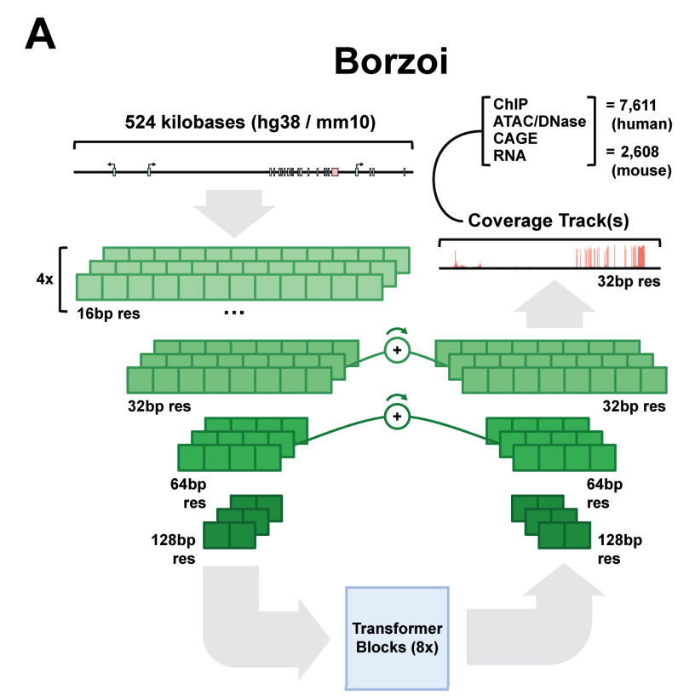
Architecture of the model
ENCODE Project:
900 human RNA-seq datasets
600 mouse RNA-seq datasets
GTEx Tissues (processed by recount3):
2-3 replicates for each GTEx tissue
Additional Regulatory Data (for identifying distal regulatory elements):
+
Enformer Model Training Datasets:
CAGE (Cap Analysis of Gene Expression) Tracks
DNase-seq Tracks (measuring DNA accessibility)
ATAC-seq Tracks (measuring chromatin accessibility)
ChIP-seq Tracks (for protein-DNA interactions, like transcription factor binding)
Notes:
The Borzoi neural network architecture consists of a number of convolution and downsampling layers, followed by a stack of self-attention layers with relative positional encodings operating at 128 bp resolution, similar to the Enformer architecture. The output is then upsampled through a number of deconvolutional layers with matched U-net connections to predict at 32 bp resolution.

Slide 9
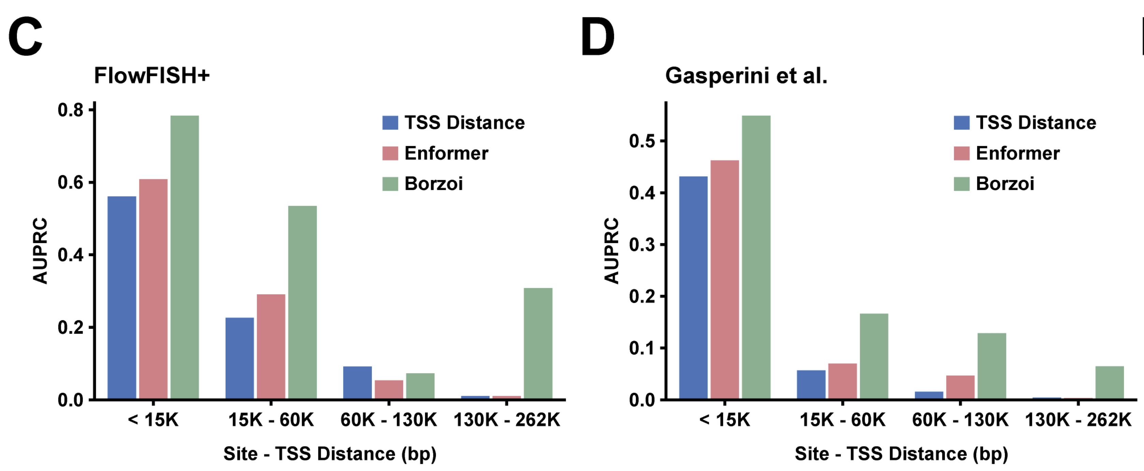
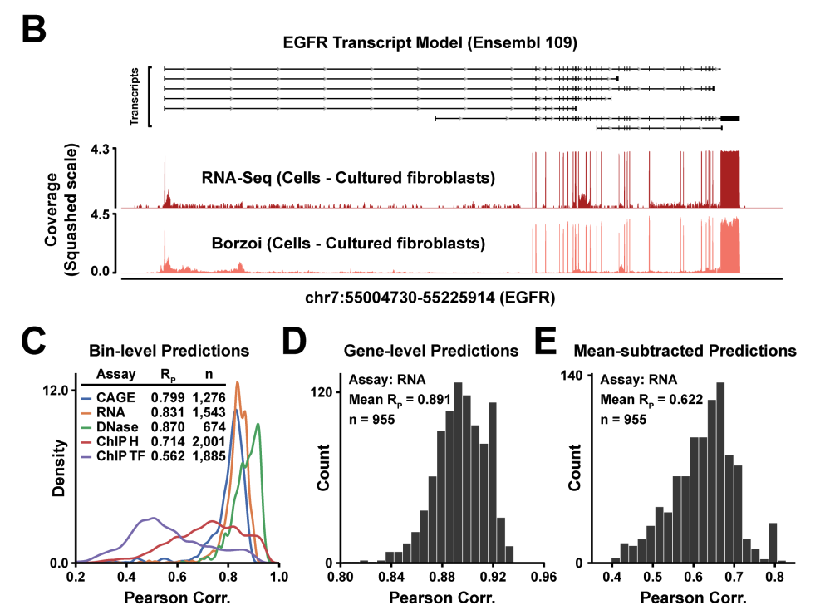
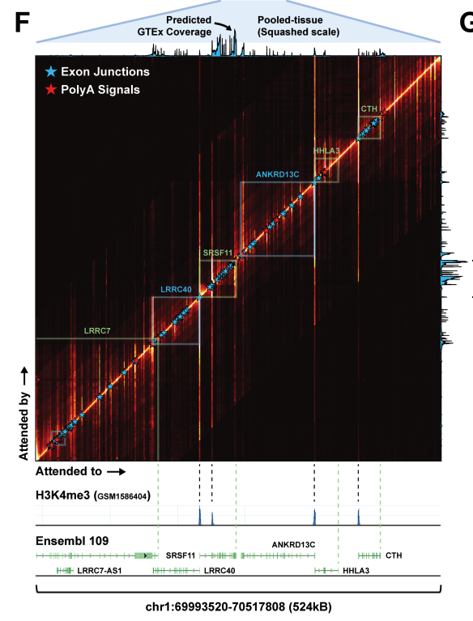
Performance of the model
Notes:
Simple Explanation: The figure shows how many connections (edges) and elements (nodes) are in different parts of the interactome, which is a network of protein interactions. The largest component is from the STRING database, followed by the OTAR dataset. Smaller contributions come from IntAct, Reactome, and SIGNOR, showing how these sources combine to form a comprehensive network.

Slide 10
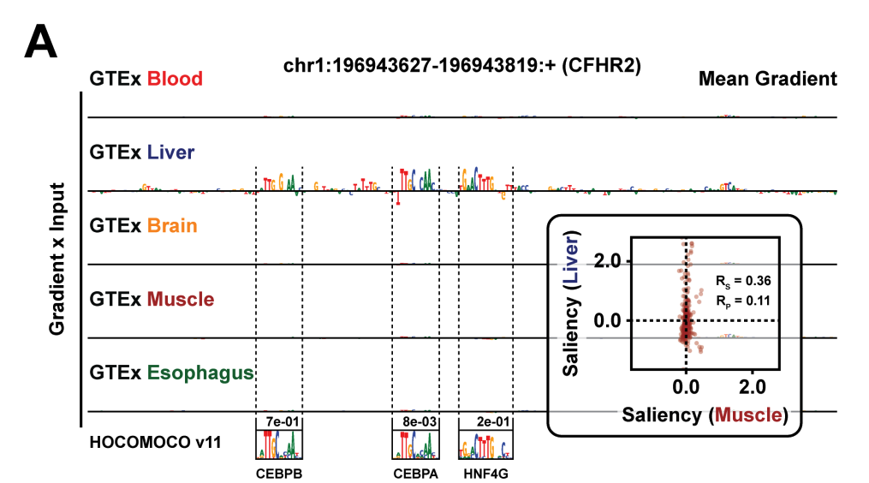
Continuing: Tissue specificity
Notes:
(A) Gradient attributions at the mode of maximum saliency for 5 GTEx tissues for liver-specific gene CFHR2. Likely motif hits and their PWMs from HOCOMOCO v11 are annotated. Inset: Comparison of nucleotide-level gradient saliencies for liver and muscle coverage tracks

Slide 11
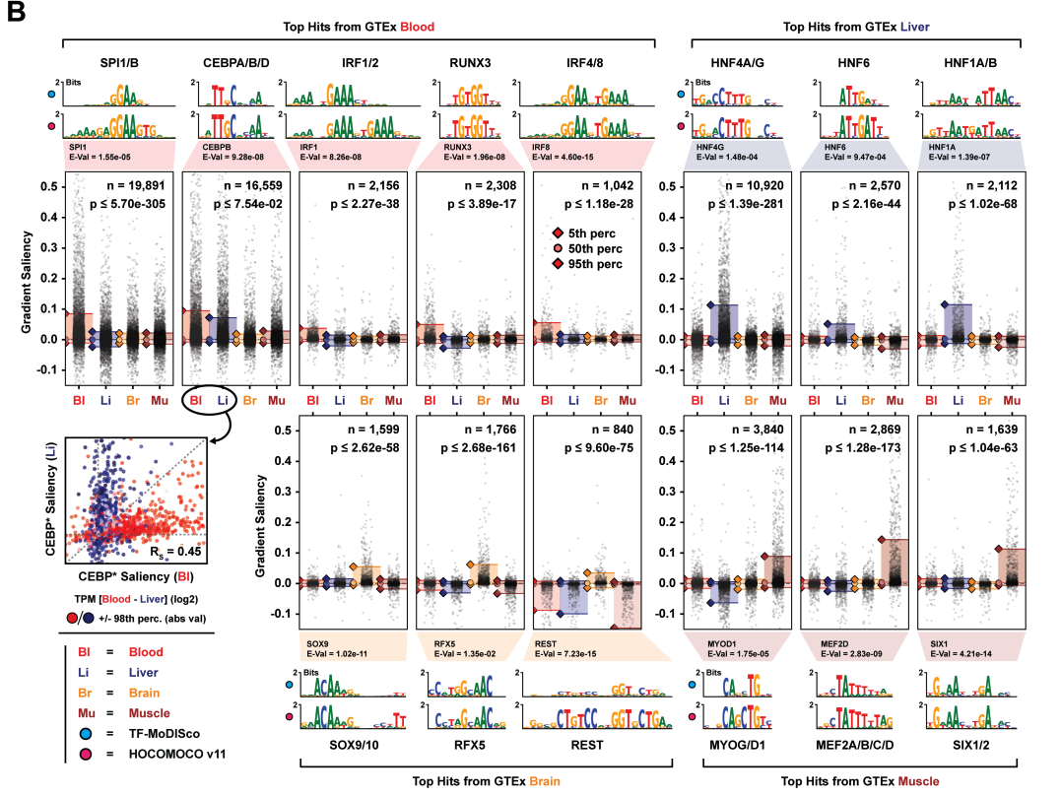
Tissue specificity
Notes:
(B) A selection of motif clusters identified by MoDISco from gradient saliencies corresponding to 4 GTEx tissues. Shown are the MoDISco PWMs, the best-matching PWMs from HOCOMOCO v11 and the distributions of tissue-specific gradient saliencies for seqlets belonging to a given cluster. P-values are computed using a two-sided Wilcoxon test between the tissue with largest absolute magnitude in gradient saliency (95th percentile) and the tissue with second largest saliency magnitude. Bottom left: Comparison of seqlet saliencies for putative CEBPA/B/D between the RNA coverage tracks of whole blood and liver.

Slide 12
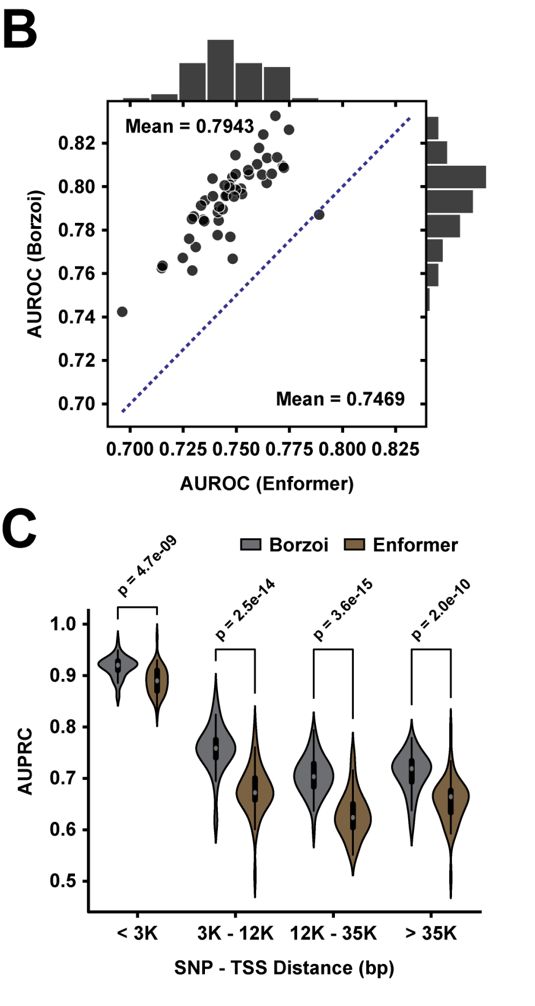
Comparing Borzoi performance to Enformer
AUROC per GTEx tissue when classifying fine-mapped causal eQTLs
Predicting the impact of context and distal regulatory elements
Notes:
Predicting the impact of context and distal regulatory elements;
AUROC per GTEx tissue when classifying fine-mapped causal eQTLs

Slide 13
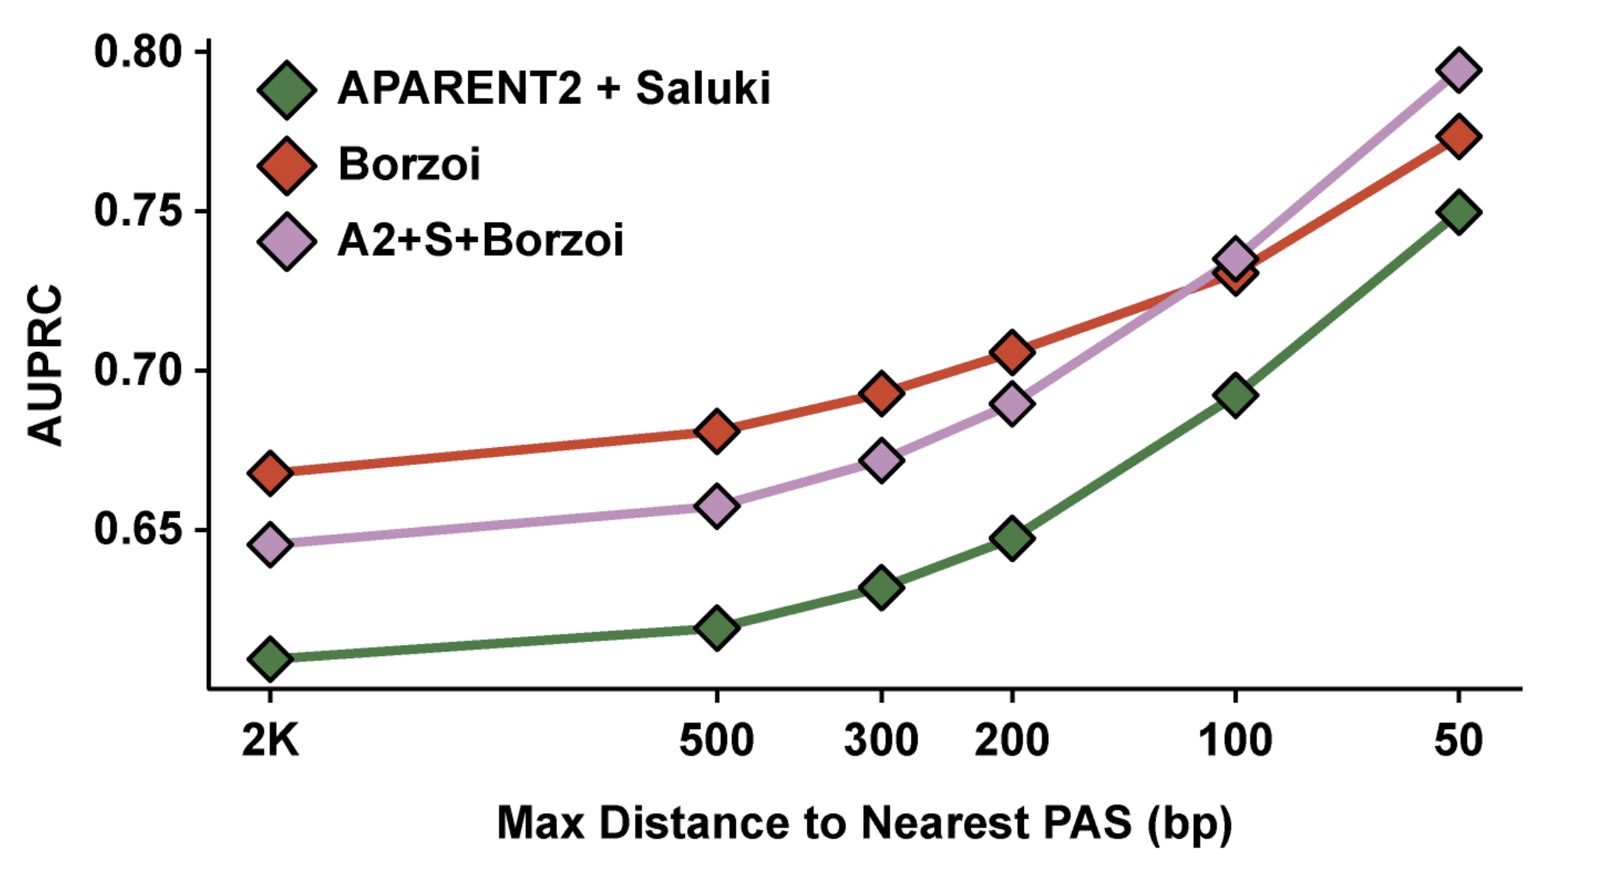
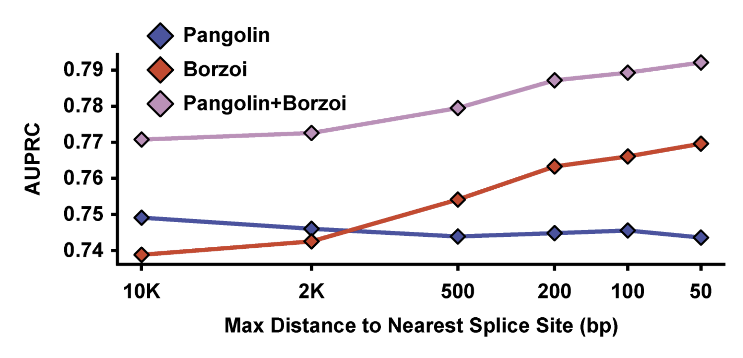
Predicting Alternative Polyadenylation and Splicing using Borzoi
Predicting Alternative Polyadenylation
Predicting Splicing
Notes:
Predicting Alternative Polyadenylation and Splicing
Predicting Alternative Polyadenylation

Slide 14
Conclusion
- Borzoi uses a transformer model to predict RNA sequencing coverage from DNA sequence with relatively high accuracy.
- Borzoi predicts RNA sequencing coverage with cell-type specificity.
- Borzoi outperforms Enformer (the previous best performing model) when predicting distal regulatory effects and eQTL variants
- Borzoi predicts alternative polyadenylation and splicing better than or no worse than previous state-of-art models, and Borzoi demonstrates superior performance when predicting distal effects

Slide 15
References
Consens, M. E., Dufault, C., Wainberg, M., Forster, D., Karimzadeh, M., Goodarzi, H., et al. (2023). To transformers and beyond: Large Language Models for the genome. arXiv [q-bio.GN]. Available at: http://arxiv.org/abs/2311.07621 (Accessed October 9, 2024).
Fudenberg, G., Kelley, D. R., and Pollard, K. S. (2020). Predicting 3D genome folding from DNA sequence with Akita. Nat. Methods 17, 1111–1117.
Karollus, A., Mauermeier, T., and Gagneur, J. (2023). Current sequence-based models capture gene expression determinants in promoters but mostly ignore distal enhancers. Genome Biol. 24, 56.
Linder, J., Srivastava, D., Yuan, H., Agarwal, V., and Kelley, D. R. (2023). Predicting RNA-seq coverage from DNA sequence as a unifying model of gene regulation. bioRxiv, 2023.08.30.555582. doi: 10.1101/2023.08.30.555582
Min, A., Schreiber, J., Kundaje, A., and Noble, W. S. (2024). Predicting chromatin conformation contact maps. bioRxivorg, 2024.04.12.589240.
Tang, Z., Toneyan, S., and Koo, P. K. (2023). Current approaches to genomic deep learning struggle to fully capture human genetic variation. Nat. Genet. 55, 2021–2022.

